Slide 1

Sae – aero micro capstone
Yacoub Almounes – Budget Liaison
John Cowan – Website Developer
Josh Gomez – Project Manager
Mohammad Qasem – Secretary/Document Manager
Michael Medulla – Client Contact

Slide 2
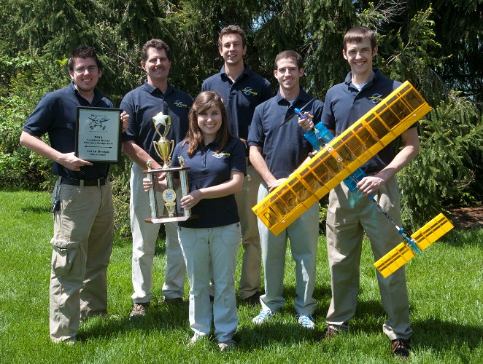
Project Description & Background
SAE International holds annual Collegiate Aero Design competition
Universities from around the world showcase aircraft designs of various sizes to convey use of resources and efficient design
Micro class required to design a radio controlled aircraft which carries the highest payload fraction possible, while maintaining lowest empty weight possible.
Judges score each design based on written report, oral presentation, flight results.
Figure 1: Cedarville SAE Aero Design Team[1]

Slide 3




Sponsors [2]
Sponsors listed supply equipment
Experienced with judging and scoring the designs
These companies recognize the most successful designs for potential future opportunities within their company.

Slide 4
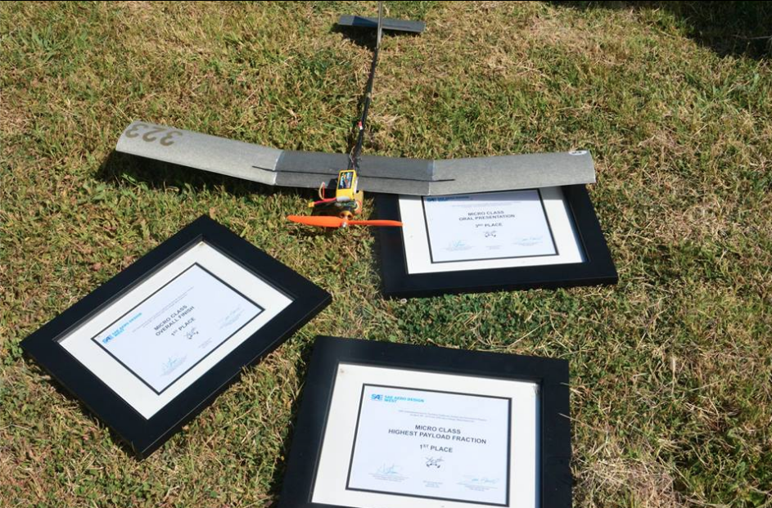
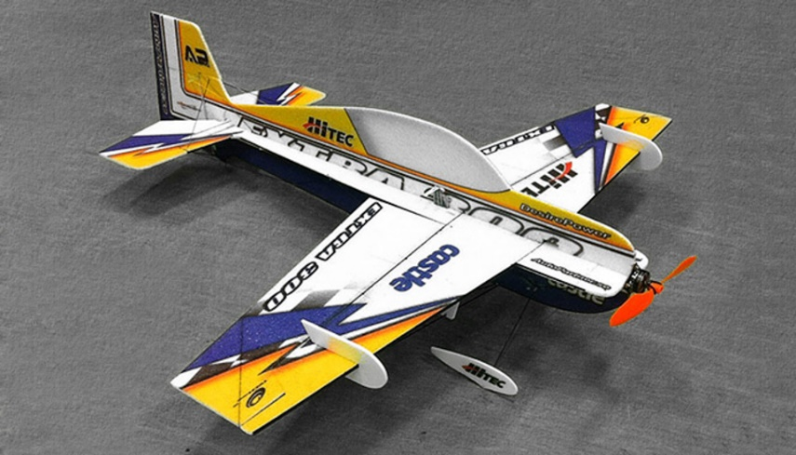
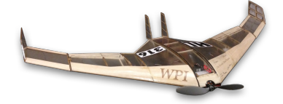
Benchmarking
Previous winner - Warsaw University of Tech.
  Composite of Carbon fiber, wood, and Ultracote
Other designs
  Flying wing
  “Foamie”
    foam construction
  3D “Foamie”
Figure 2: Warsaw Aero Design [3]
Figure 3: “Foamie” Design [4]
Figure 4: Flying Wing Design[5]

Slide 5
Customer requirements
Customer Requirements | Weighting
Aircraft Identification | 2
Empty CG Design Requirement and Empty CG Markings | 5
Aircraft Conformance to 2D Drawing | 3
Aircraft uses a 2.4 GHz radio control system | 4
No metal prop | 3
No lead used in any portion of the aircraft or payload | 5
Payload does not contribute to the structural integrity of the airframe | 4
Ballast not installed in closed payload bay | 4
Ballast stations must be indicated on 2D drawing | 1
Ballast must be properly secured to avoid shifting or falling off the aircraft | 5
Aircraft is powered only by the Engines/Motors | 4
All servos properly sized for aircraft | 5
All linkages secure | 5
Aircraft Container | 3
Payload dimensions | 5
Payload removable side | 4
Payload prevent weight shifting | 5
Payload must be removable | 2
Battery ( 3 cell 2200 mAh) | 5
Safety | 5
Weightings are numbered 1 (least important) through 5 (most important)

Slide 6
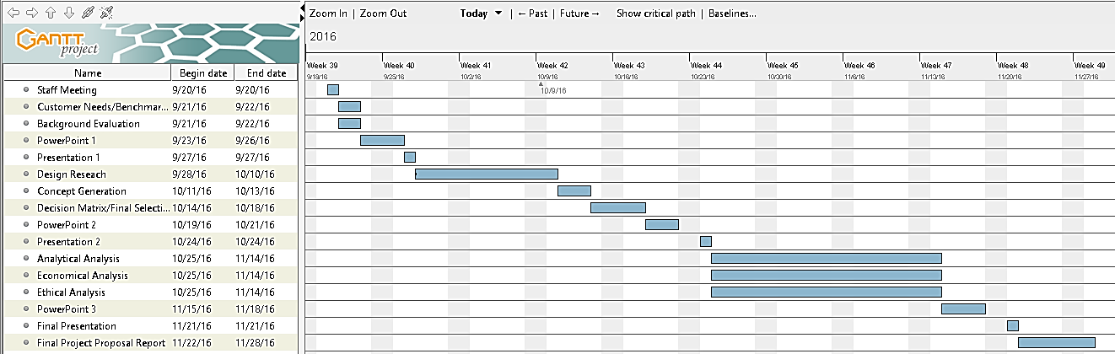
Schedule

Slide 7
Important dates and budget
Important Dates
Description | Date
Registration Open | October 3, 2016
Registration Closed | November 14, 2016
Design Reports 2D Drawings Tech Data Sheet | January 26, 2017
Competition Date | March 10-12, 2017
Budget (Total Received: $1,500)
Anticipated Expenses
Registration | $1,000
Materials | $400
Travel | $100

Slide 8
Awards for sae aero micro class
SAE international Overall Micro Class Award ($1,000, $750, $500)
Elliot & Dorothy Green Overall Regular Class Award ($1,000, $750, $500)
Micro Class Written Design Report
Micro Class Oral Presentation
Highest Payload Fraction
Highest Payload Lifted

Slide 9
References
[1] “Aero Design Team Soars to Success at Competition” Cedarville University,c 2011 [Online] Available: http://www.cedarville.edu/Offices/Public-Relations/CampusNews/2011/Aero-Design-Competition.aspx
[2] “Sponsors” SAE Aero Design West, 2016 [Online] Available: http://students.sae.org/cds/aerodesign/west/sponsors/
[3] “Warsaw University of Technology” Facebook, 2015 [Online] Available: https://www.facebook.com/WarsawUniversityofTechnology/posts/1622991347936233
[4] NITROPLANES [Online] Available: http://www.nitroplanes.com/02a-704-extra300-epp-3d-arf.html
[5] K. Catherine et al, “Micro Aircraft Competition Design” Worcester Polytechnic Institute, 2013 [Online] https://web.wpi.edu/Pubs/E-project/Available/E-project-042413-141253/unrestricted/Final_MQP_Report_-_Micro_Aircraft_Flying_Wing.pdf

